Slide 1
The Data Analysis Process
-Fahim faisal sifat

Slide 2
What is the Data Analysis ?
Data analysis is the process of inspecting, cleaning, transforming, and modeling data to discover useful information, draw conclusions, and support decision-making

Slide 3
The Data Process steps
Step 1: Asking Questions Imagine you work for a retail company, and you want to analyze customer purchasing behavior. Your initial question could be: "What factors influence customers to make repeat purchases?“
Step 2: Data Wrangling (Cleaning) You collect data from various sources, including customer transaction logs. However, the data is messy, with missing values and duplicate entries. For instance, you notice that some transactions have missing purchase dates, and there are duplicate customer IDs in the dataset. You clean the data by removing duplicates and imputing missing purchase dates.
Step 3: Exploratory Data Analysis (EDA) During EDA, you create visualizations and conduct statistical analyses. You generate a bar chart showing the distribution of purchase frequency among different customer segments. EDA reveals that customers in the 25-34 age group tend to make the most frequent purchases.
Step 4: Drawing Conclusions Based on your EDA, you draw the conclusion that age is a significant factor influencing repeat purchases. Younger customers in the 25-34 age group are more likely to make repeat purchases compared to other age groups. You might also infer that marketing strategies targeting this age group could be more effective in increasing customer retention.
Step 5: Communicating Results To communicate your findings, you create a detailed report and presentation for the company's marketing team. Your presentation includes charts and graphs illustrating the age-based purchasing behavior, along with actionable recommendations, such as designing marketing campaigns specifically targeting the 25-34 age group to encourage repeat purchases.

Slide 4
Step 1: Asking Questions
Subject matter expertise
Experience
# Step 1: Asking Questions
# Objective:
# Determine the factors that contribute to customer churn in our subscription-based service.
# Questions to Address:
# 1. What is the current churn rate?
# 2. Are there specific demographics or customer segments more prone to churn?
# 3. What are the common reasons customers cancel their subscriptions?
# 4. Can we identify any patterns or trends that could help reduce churn?
# Hypothesis:
# We hypothesize that customers in the 18-24 age group are more likely to churn due to budget constraints.

Slide 5
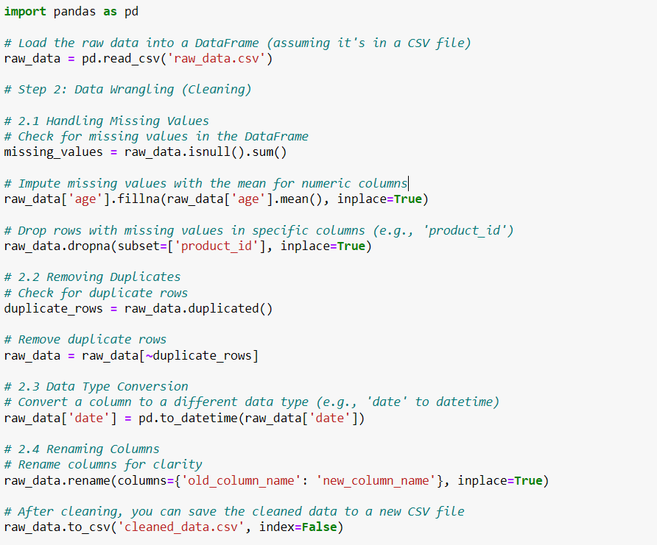
Step 2: Data Wrangling (Cleaning)
Gathering data
( CSV , API , WEB SCRAING ,DATABASE)
Assessing data
( Shape , info , unique )
Cleaning data
( missing data > if mean ,
drop_duplicates , astype)

Slide 6
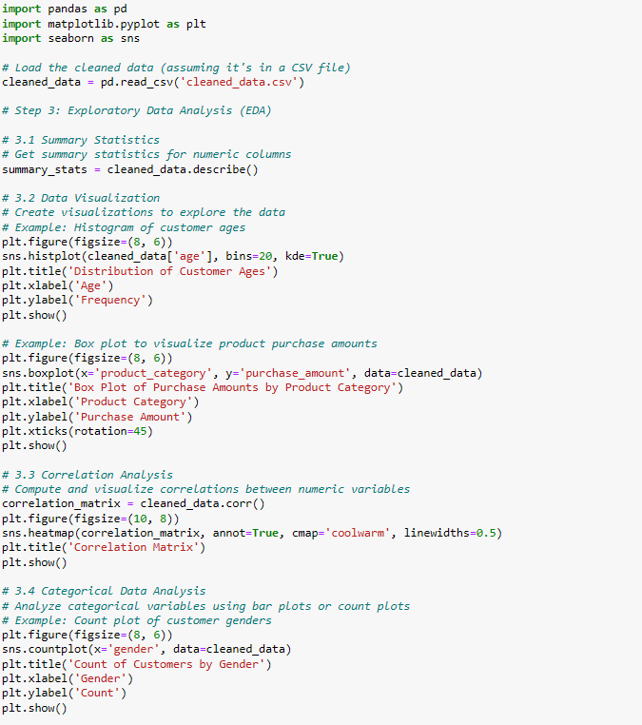
Step 3: Exploratory Data Analysis (EDA)
Explore
Data visualization
Augment
merging data frame
(data_set1 1, data_set2 )

Slide 7
Drawing Conclusion
Machine learning
Statistics
Descriptive Statistics

Slide 8
Communicating result
Story telling

